Slide 1


EduLearn
Online Course Enrollment Platform (Prototype)
ACADEMIC PROJECT
6-MEMBER TEAM

Slide 2



Empowering Students Through Online Education
INTRODUCTION
What is EduLearn?
Why It Matters Today
A web-based prototype designed to simplify how students discover and enroll in professional development courses
Online learning has transformed education:
Accessible education anytime, anywhere
Professional skill development at your pace
Growing demand for flexible learning solutions
Bridge between academic and career skills
Focus areas:
Intuitive user interface design
Smart course categorization
Streamlined enrollment flow

Slide 3


The Problem We're Solving
CHALLENGE
Fragmented Course Discovery
Students struggle to find structured professional courses across multiple scattered platforms
Complex Enrollment Processes
Existing platforms often have confusing navigation and overwhelming interfaces
Lack of Clear Organization
Courses aren't categorized effectively, making it hard to find relevant learning paths
"Students need a simple, centralized platform that makes course discovery and enrollment effortless"

Slide 4

Project Objectives
01 02
Design Excellence
Create a responsive and intuitive course enrollment website with modern UI/UX principles
Clear Navigation
Showcase course categories and enrollment options through logical, user-friendly pathways
03
Proof of Concept
Demonstrate core functionality as a working prototype ready for future development

Slide 5


What EduLearn Offers
FEATURES
Engaging Home Page
Clear call-to-action buttons and intuitive design that welcomes users and guides them to courses
Organized Categories
Five main areas: Technology, Business, Design, Marketing, and Languages
Detailed Course Listings
Each course shows level, duration, instructor info, and transparent pricing
Enroll Now Function
Prototype-level enrollment system demonstrating the user journey from discovery to action

Slide 6



User Interface Design Philosophy
Clean & Modern
Minimalist aesthetic that puts content first
Easy Navigation
Home • Courses • About • Contact
Mobile-Friendly
Fully responsive across all devices
Design Priority: User experience drives every interface decision
Our design ensures students can navigate effortlessly whether they're on desktop, tablet, or smartphone

Slide 7


TECH STACK
Technologies Powering EduLearn
Frontend Development
HTML, CSS, JavaScript for core functionality
Design & Prototyping
Lovable AI for rapid design iteration
Deployment
Prototype hosting environment

Slide 8

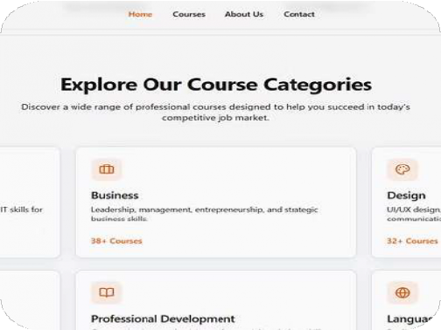
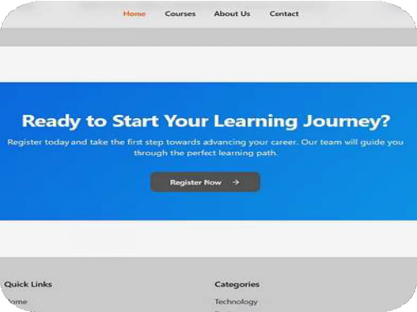
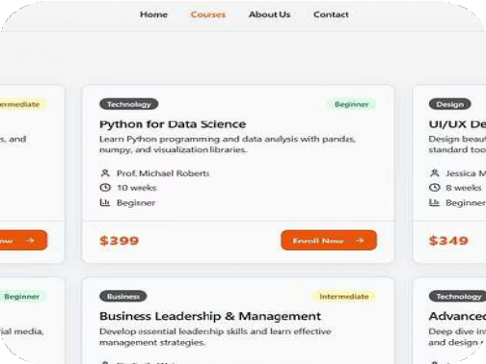
Platform Screenshots
Visual walkthrough of the EduLearn user experience

Slide 9

Current Limitations & Future Vision
Present Constraints
Backend Integration
Database not fully connected yet
Static Content
Courses currently hard-coded
Missing Features
No video content or payment gateway in this prototype phase
Future Enhancements
Dynamic Data
Full database integration for real-time course management
User Authentication
Secure login and personalized dashboards
Rich Content
Video-based courses with interactive elements
Payment System
Integrated payment gateway and enrollment confirmation

Slide 10


Thank You
6
Team Members
Collaborated to bring EduLearn to life
5
Course Categories
Organized learning pathways
1
Vision
Simplify online learning for everyone
EduLearn demonstrates strong UI design and user flow planning
A solid foundation for building the future of accessible online education

